Slide 1
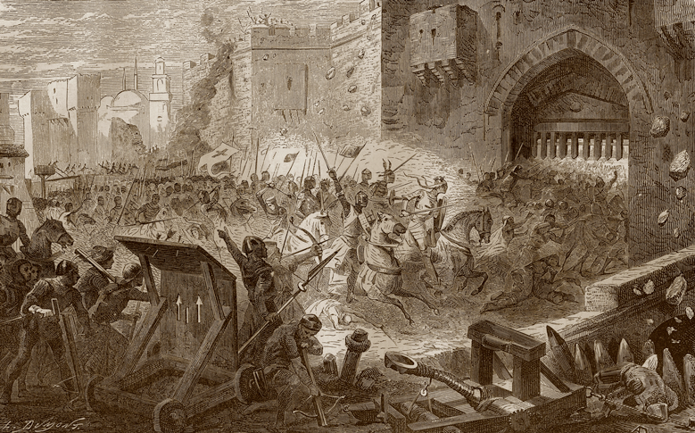
The Muslim World and Africa (730 B.C.-A.D. 1500)
Lesson 4 The Ottoman and Safavid Empires

Slide 2
The Muslim World and Africa (730 B.C.-A.D. 1500)
Lesson 4 The Ottoman and Safavid Empires
Learning Objectives
Explain the impact of the Ottoman empire on Eastern Europe.
Describe the characteristics of Ottoman culture.
Explain how Abbas the Great strengthened the Safavid empire.

Slide 3
Growth of the Ottoman Empire
The Ottomans Conquer Constantinople
Ottomans are Turkish speaking nomads from Central Asia
Fighting the last bit of Byzantine Empire, capture Constantinople under Sultan Mehmet II by transporting ships overland to the harbor
Use cannons to take out the walls, Const. becomes Instanbul
Suleiman the Magnificent
Ruled from 1520-1566
Went east into the Middle East
Went west into Europe, and tried to take Vienna
The French, in hopes of weakening rivals The Hapsburg Empire sign a treaty with the Ottomans. This allows French merchants to travel into the Ottoman Empire, unlike other European merchants

Slide 4
Growth of the Ottoman Empire
Ottomans Control Trade
The Ottomans control major trade routes making Istanbul very wealthy
1533 Suleiman creates a large fleet to take control of Eastern Mediterranean Sea
Eventually the Portuguese and others will go around Africa to end control of land and sea routes by the Ottomans
Ottoman Government
Empire stretched from Hungary to Mesopotamia to across North Africa
Suleiman will be Emperor and Protector of the Sacred Places (Mecca and Medina)
Suleiman will rule with a grand council and a Vizier, a huge bureaucracy for the government and an army to keep the peace

Slide 5
Growth of the Ottoman Empire
Until the Ottomans invaded, the high, thick walls and well-positioned defenses of Constantinople had repelled invaders for a thousand years.

Slide 6
Ottoman Society
Religion in Ottoman Society
The men of sword and pen were Muslims while others included non Muslims
Other religious groups were organized in millets, or religious communities
Millet leaders were responsible for education and some legal matters
Jewish millets bring international banking connections and a new technology for making cloth. They come from Spain in 1492
Treatment of Conquered Peoples
They recruit officers from conquered people
In the Balkans they take the boys, convert them to Islam, give them military training at the palace. The best join the elite forces and the brightest are sent to schools to become government officials. Girls became slaves in wealthy households

Slide 7
Ottoman Society
Literature and the Arts
Ottoman poets work to produce Arab and Persian works into Turkish
The royal architect Sinan builds the Selimiye Mosque and compares it to the Hagia Sophia and says the dome is bigger
Decline of the Ottomans
After Suleiman’s death in 1566, the empire starts to change. His successor Selim II leaves the ruling to the ministers and you have corruption
By the 1700’s European advance in commerce and technology, leaving the Ottomans behind.
Russia and other European powers take over Ottoman lands
North African rulers will break away from the Ottomans

Slide 8
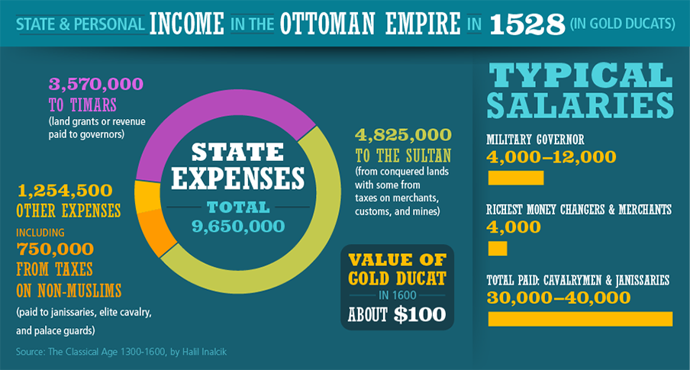
Ottoman Society
Under the Ottoman empire, trade thrived and many people attained great wealth, particularly local rulers.

Slide 9
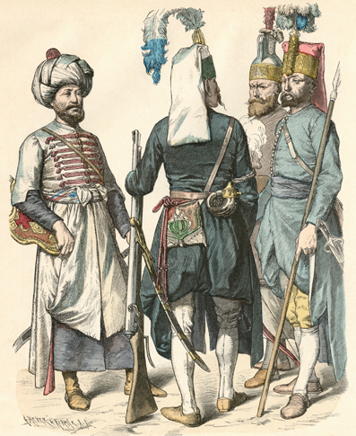
Ottoman Society
The janizaries, or the elite military force made up mostly of converted Christians, suppressed any revolt within the Ottoman empire because they controlled the military, even dethroning Sultan Beyezid II.

Slide 10
The Rise of the Safavids
Abbas the Great
Ruled from 1588 to 1629
Centralized government, sought allies with European powers who were wary of the Ottomans
Reduces taxes on farmers and herders in order to encourage the growth of Industry
Builds new capital at Isfahan
A Center of Art and Trade
Isfahan becomes the center of arts, architecture and silk trade
Abbas brings Armenians to Isfahan because they are the best silk producers in the world. They settle outside the city and rule their community

Slide 11
The Rise of the Safavids
The Decline of the Safavid Empire
The Safavid empire declines with the death of Shah Abbas
The Ottoman armies keep attacking
The Shiite scholars challenge the power of the Shah
The Shiites encourage persecution of religious minorities leading to the rebellion of the Sunni Afgans
This rebellion will lead to the abdication of the last Safavid ruler in 1722
Even with this loss the Safavid empire will firmly establish Shiites in Iran
In the late 1700’s the Qajars will form a new dynasty until 1925, they will make Tehran their capital

Slide 12
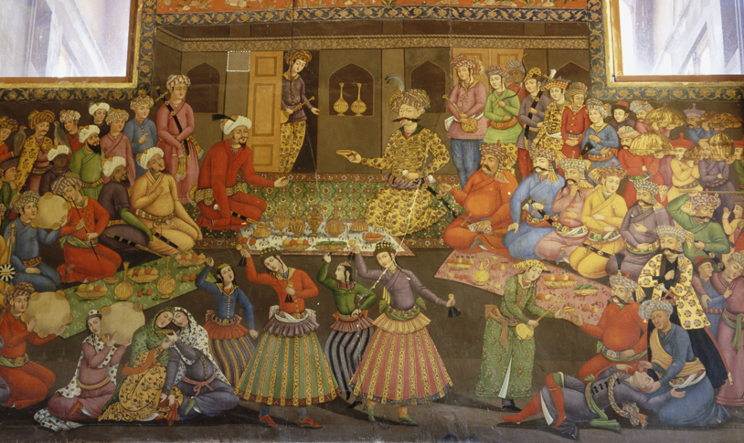
The Rise of the Safavids
Shah Abbas used the formal setting of his court and also mingled informally with his people in order to provide a just rule for the Savavid empire.

Slide 13
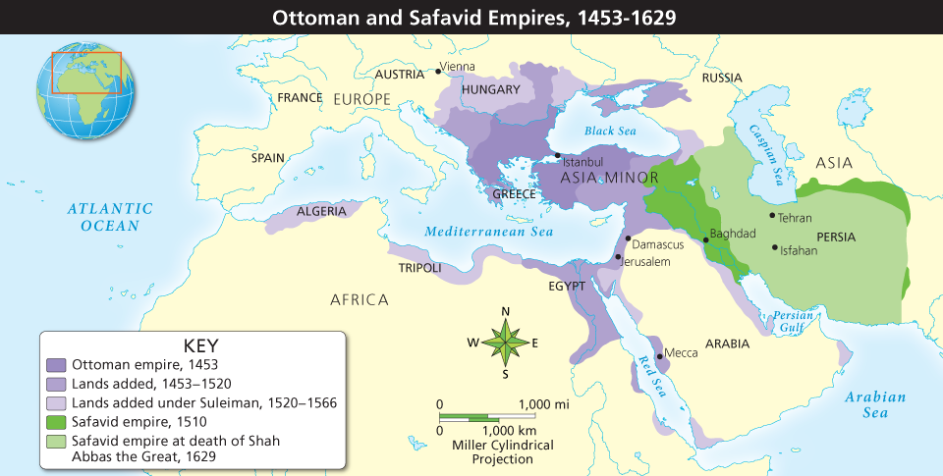
The Rise of the Safavids
Analyze Maps At its greatest extent, the Ottoman empire stretched across three continents, while the Safavid empire controlled most of what is today Iran. Into what regions did the Ottoman empire expand under Suleiman?

Slide 14
Quiz: Growth of the Ottoman Empire
Why did conquering Constantinople strengthen the Ottoman empire?
A. It helped in overcoming the Safavids.
B. It allowed expansion into Africa.
C. It gave the Ottomans a trading center and a governmental and cultural capital.
D. It prevented the rise of Portuguese and European navies.

Slide 15
Quiz: Ottoman Society
Given the importance of class divisions in the Ottoman empire, the best hope for the sons of those peoples the Ottomans conquered was to become
A. janizaries.
B. merchants.
C. tax collectors.
D. farmers.

Slide 16
Quiz: The Rise of the Safavids
How did the fact that the Safavids were Shiite Muslims affect relations with the Ottomans?
A. Even though they shared a common religion, they were also neighbors, so they constantly fought over disputed territories.
B. Both were united in their determination to win a holy war against Christian Europe.
C. Ottomans attacked Shiite Muslims in Afghanistan, forcing the Safavids to fight Afghanistan.
D. Religious differences increased conflict between the two empires because each was composed of a different sect of Islam.

